Slide 1
Unit 4 Energy & Power
Part A: Introduction of Energy and Power

Slide 2
What will you learn?
What energy is.
Relationship between energy and power.
Symbols and units of energy and power.

Slide 3
What is “energy”?
We learned about “work done” in science. For example, a force of 5 N (newton) is applied to push an object for a distance of 10 km, work done = 5 N × 10 km = 50 kJ (kilojoules).
∴ 50 kJ of energy is spent to do the work.
Energy is the capacity to do work, generate heat or light.
Energy is represented by the symbol, W.
The unit of energy is joule (J).

Slide 4
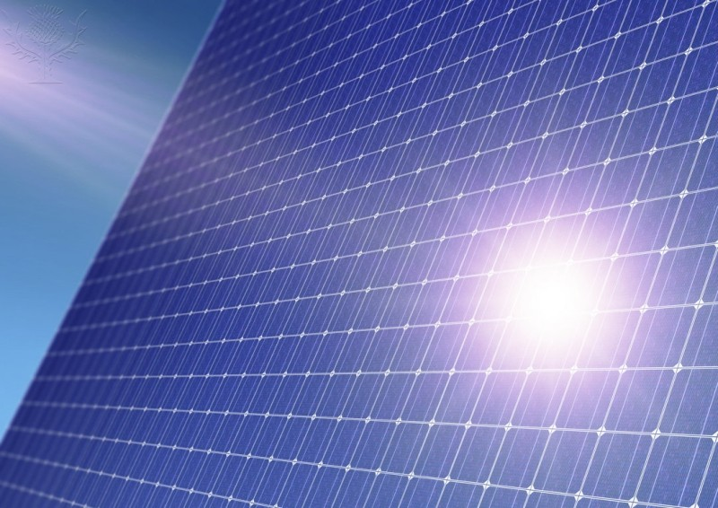
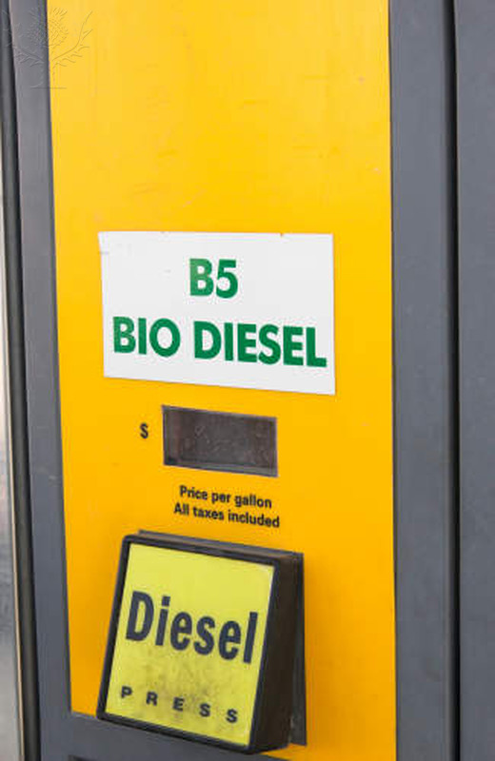
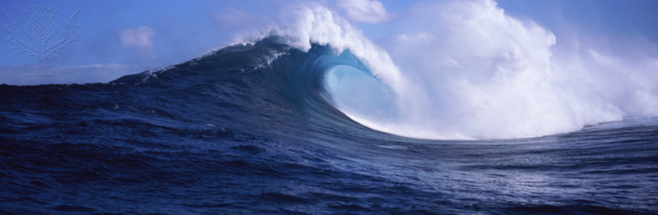
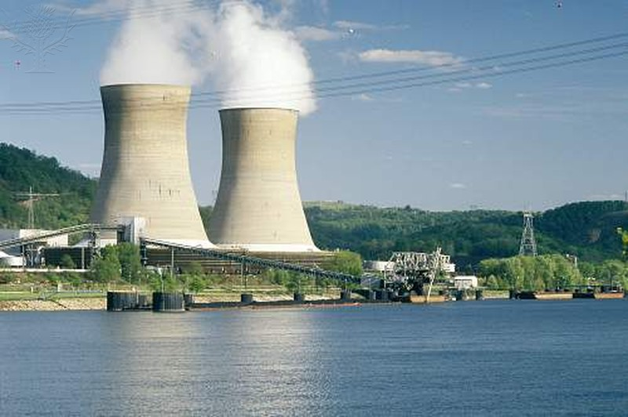
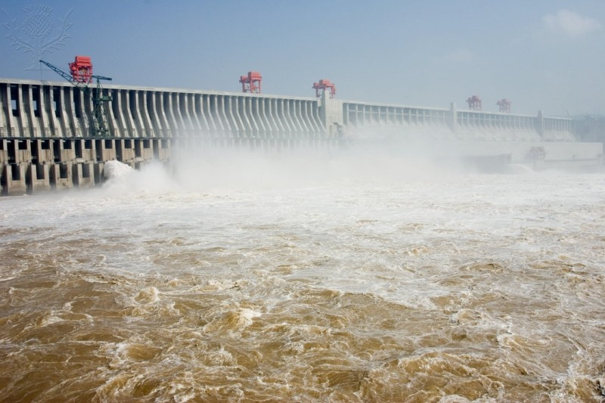
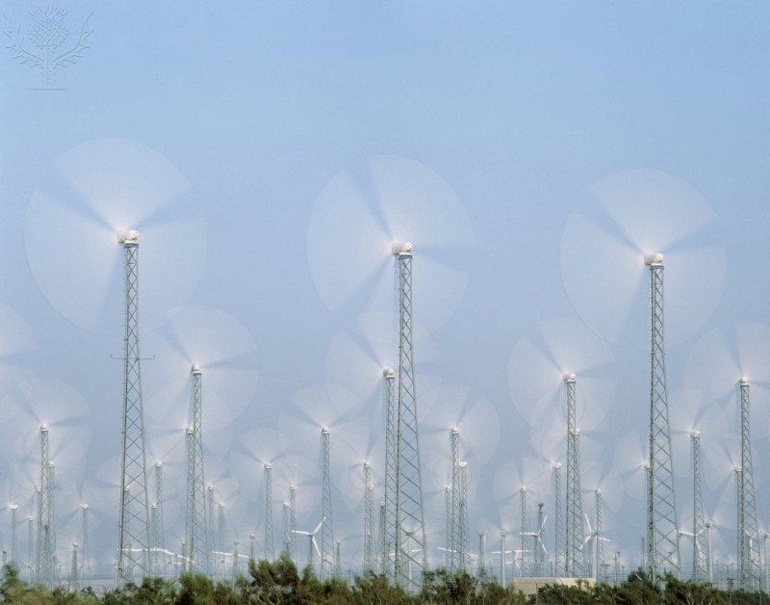
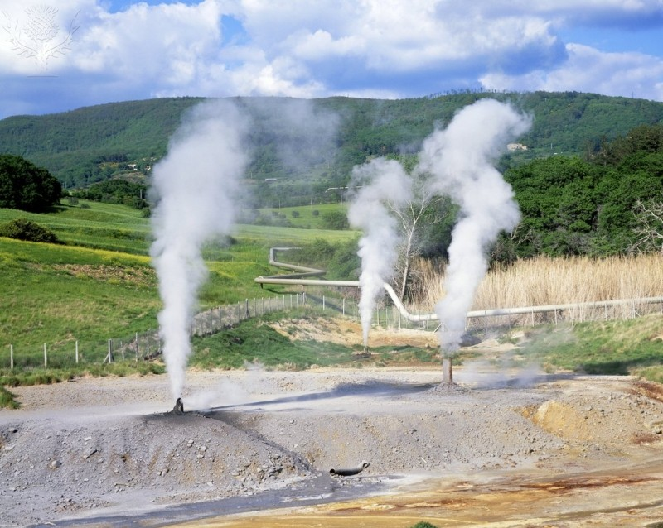
What is “energy”?
Energy comes in various forms.
Energy is generated by the sun: solar energy.
Solar energy is locked in biomass through process of photosynthesis and is released when it is burned or decomposed, e.g. biogas.
Energy is stored in oceans and released through tidal waves.
Other forms include wind, hydro, geothermal, chemical and nuclear, and so forth.

Slide 5

What is “power”?
When you release your energy, say 20 kJ, to do work, the rate of releasing that amount of energy per unit time is called power.
Power has a symbol P.
Its relationship with Energy (W) is
Its unit is watt (W).
$$P=\frac{W}{t}$$

Slide 6

$$P=\frac{W}{t}$$
What is “power”?
If you release 20 kJ of energy in 10 seconds, power = 2 kW.
For the same amount of energy released in 2 seconds, power = 10 kW.
The power is increased if the same amount of energy is released in a shorter duration.

Slide 7
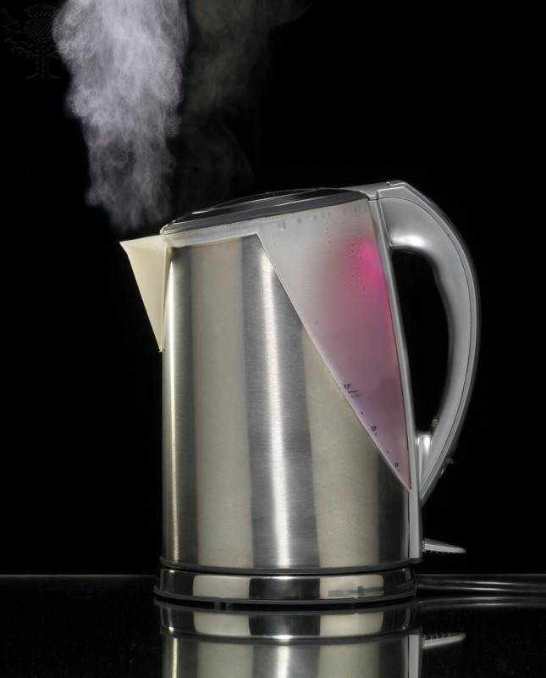


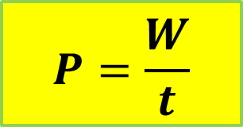
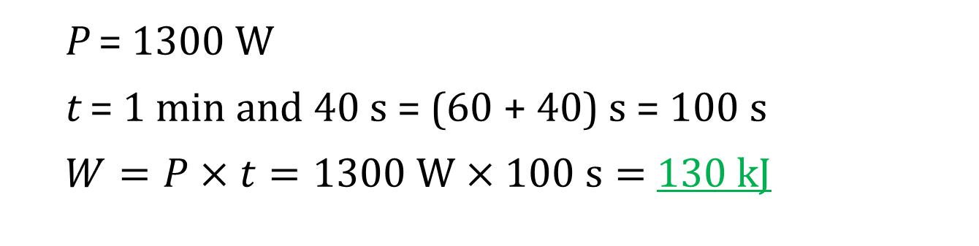
Example 1: A 1300 W electric kettle takes 1 minute and 40 seconds to boil its water. How much energy is consumed?
P = 1300 W
t = 1 min and 40 s = (60 + 40) s = 100 s
$W=P×t=1300 W×100 s=$ 130 kJ
$$P=\frac{W}{t}$$

Slide 8
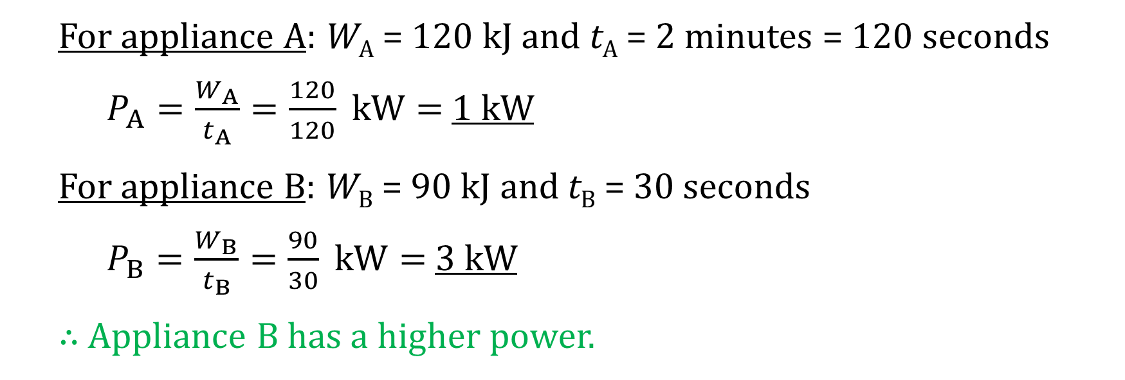
Example 2: Appliance A consumed 120 kJ of energy in 2 minutes while appliance B consumed 90 kJ of energy in 30 seconds. Which appliance has a higher power?
For appliance A: W_{A} = 120 kJ and t_{A} = 2 minutes = 120 seconds
$P_{A}=\frac{W_{A}}{t_{A}}=\frac{120}{120} kW=$ 1 kW
For appliance B: W_{B} = 90 kJ and t_{B} = 30 seconds
$P_{B}=\frac{W_{B}}{t_{B}}=\frac{90}{30} kW=$ 3 kW
∴ Appliance B has a higher power.

Slide 9
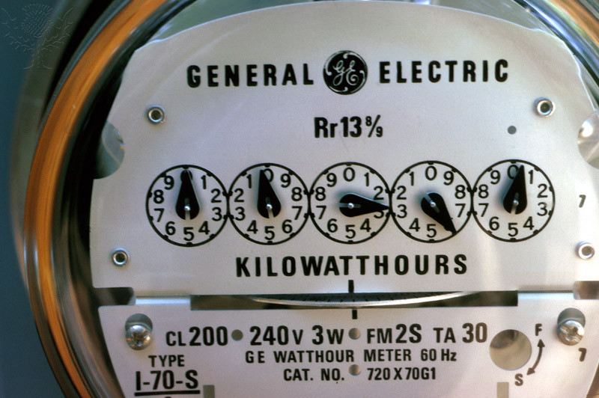

Electrical power measured in kWh
When you pay your electricity bill, you are charged on the amount of electrical energy you have consumed over a period, say a month.
Your energy company uses watt-hour (Wh) or kilowatt-hour (kWh) as this is more practical when dealing with large quantity of energy.
The time is measured in hours instead of seconds.
$$W=P×t$$

Slide 10
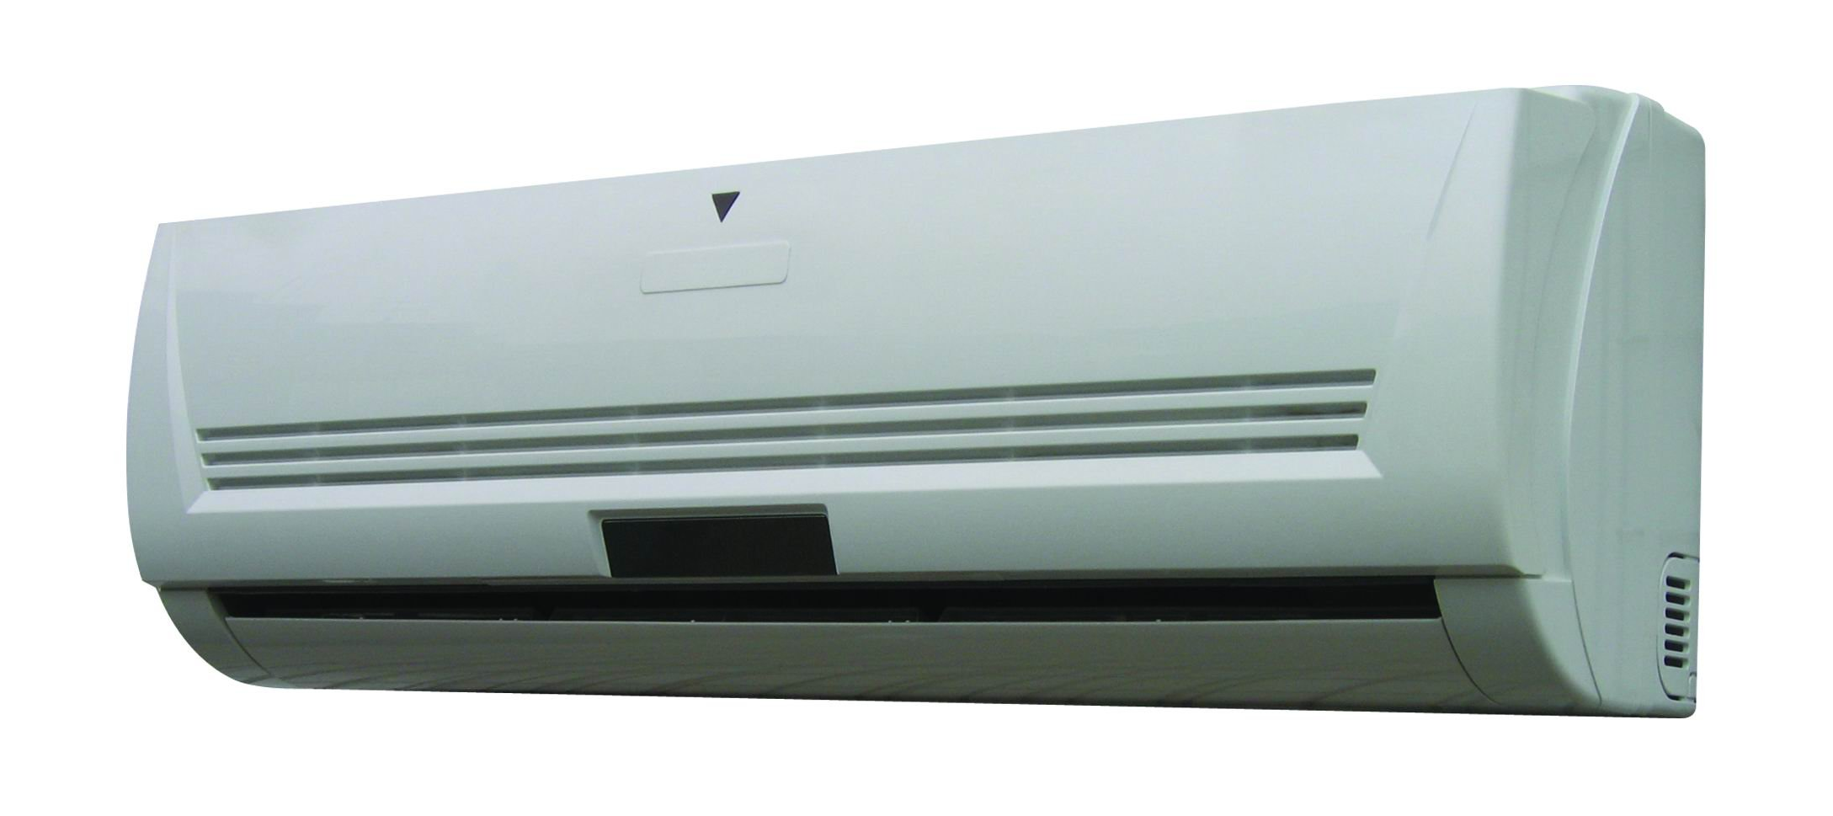
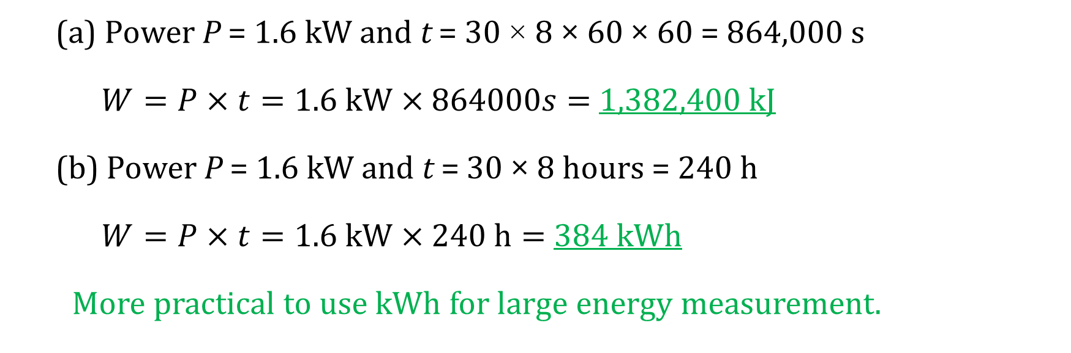
Example 3: A 1.6 kW air-conditioner operates 8 hours every day. Calculate the energy consumed for 30 days in: (a) kJ and (b) kWh.
(a) Power P = 1.6 kW and t = 30 × 8 × 60 × 60 = 864,000 s
$W=P×t=1.6 kW×864000s=$ 1,382,400 kJ
(b) Power P = 1.6 kW and t = 30 × 8 hours = 240 h
$W=P×t=1.6 kW×240 h=$ 384 kWh
More practical to use kWh for large energy measurement.

Slide 11
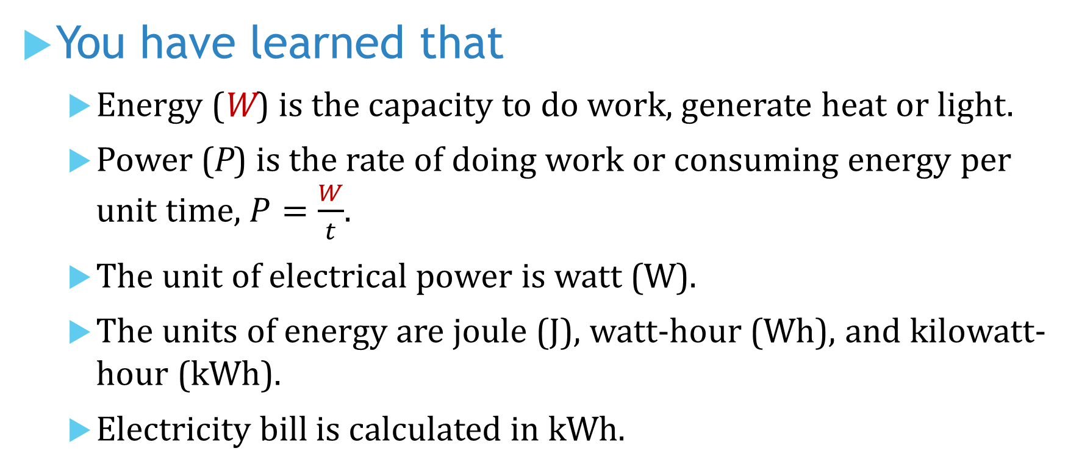
You have learned that
Energy (W) is the capacity to do work, generate heat or light.
Power (P) is the rate of doing work or consuming energy per unit time, $P=\frac{W}{t}$.
The unit of electrical power is watt (W).
The units of energy are joule (J), watt-hour (Wh), and kilowatt-hour (kWh).
Electricity bill is calculated in kWh.

Slide 12
Coming Up Next
Power in an Electric Circuit

